Slide 1
Mommy Dentists in Business

Slide 2
Recommended medications for acute dental pain
INDIVIDUAL CARE
Khawaja SN & Scrivani, SJ Dent Clin NA 64, 525 2020
Based on: ADA Practical Guide to Substance Use Disorders and Safe Prescribing (May 8, 2015):
a-Q4-6H, b-Q8H, c-Q12H

Slide 3
INDIVIDUAL CHOICE OF ANALGESIC
The number needed to treat after a single dose of medication for treatment of acute dental pain (95% Confidence Limit)
Acetaminophen, 1000 mg, with ibuprofen, 400 mg 1.5 (1.4–1.7)#
Acetaminophen, 1000 mg, with oxycodone, 10 mg 1.8 (1.6–2.2)#
Ibuprofen, 200 mg, with caffeine, 100 mg 2.1 (1.8–2.5)
Ibuprofen, 400 mg, with oxycodone, 5 mg 2.2 (1.8–2.9)
Acetaminophen, 1000 mg, with codeine, 60 mg 2.2 (1.8–2.9)
Diclofenac, 50 mg 2.3 (2.0–2.7)
Oxycodone, 15 mg 2.4 (1.4–4.4)*
Ibuprofen, 400 mg 2.4 (2.3–2.6)*
Naproxen, 550 mg 2.6 (2.2–3.2)
Acetaminophen, 650–975 mg, with tramadol, 75 mg 2.6 (2.3–3.0)
Acetaminophen, 500 mg 3.5 (2.7–4.8)
Acetaminophen, 1000 mg 3.6 (3.2–4.1)
Celecoxib, 200 mg 4.2 (3.4–5.6)
Tramadol, 75 mg 9.9 (6.9–17.0)
Codeine, 60 mg 12.0
Codeine, 30 mg 16.7
Adapted from; Khawaja & Scrivani Managing Acute Dental pain Dent Clin NA 64 2020 525-534

Slide 4
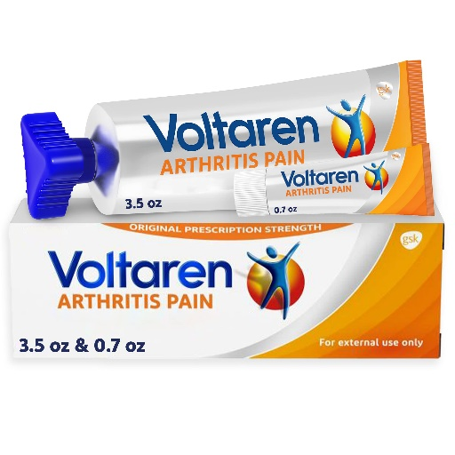
Other nonsteroidal anti-inflammatories*
NAME | DOSES | SCHEDULE | MAXIMUM
Naproxen (Aleve, Naproxen) | 250, 375, 500 mg | 250 – 500 mg | 1500 mg/day x 3-5 days
Ketoprofen (Toradol) | 12.5, 50, 75 mg | 25 – 50 mg q6-8h | 300 mg/day
Meclofenamate sodium (Meclomen) | 50 , 100mg | 50 – 100 q6-8h | 400 mg/day
Piroxicam (Feldene) | 10, 20 mg | 20 mg day | 20 mg/day
Diclofenac (Voltaren)# | 25, 50, 75mg | 50 mg bid-tid | 150mg / day
Nabetone (Relefan) | 500 , 700mg | 500 – 2000 mg/day | 2000 mg/day
* Effectiveness varies between groups/mechanism of action
# OTC 1% Gel

